Slide 1

ELECTRONICS 101
BREADBOARD

Slide 2


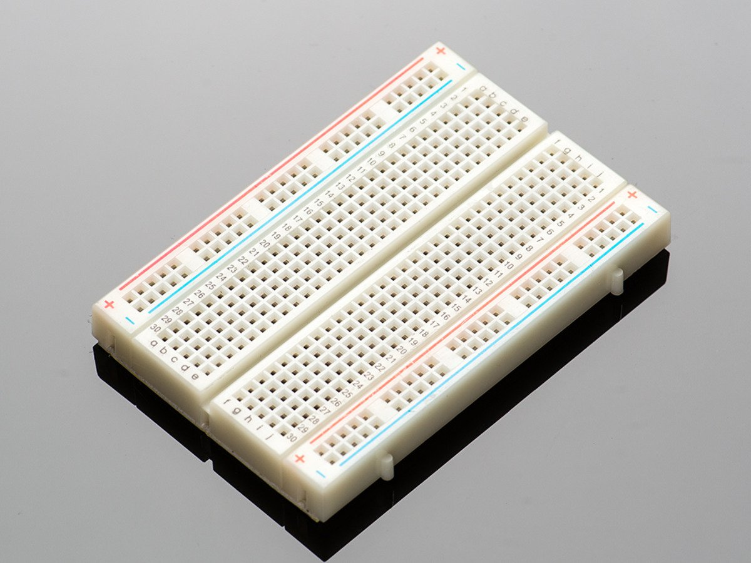
WHAT IS A BREADBOARD?
A tool that is used to insert electronic components
Good for experimenting and prototyping circuits
Comes in different sizes
Sold everywhere

Slide 3
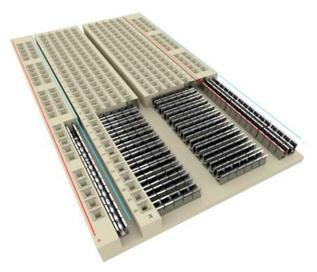
ANATOMY OF BREADBOARD

Slide 4
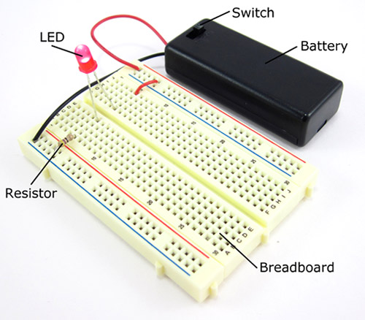
EXAMPLE OF A CIRCUITS BUILT ON A BREADBOARD

